Slide 1
Capital Asset Pricing Model (CAPM) and
Multi-Factor Models
Dr. Natasha Todorovic
(natasha.Todorovic.1@city.ac.uk)

Slide 2
Portfolio Theory vs. Capital Markets Theory
Portfolio Theory - normative economics
  investors are told how to invest, i.e. identify the optimal portfolio
    optimal portfolio is where investors indifference curve is tangent to the efficient set
Capital Market Theory - positive economics
  describes how the assets are priced
  assumes that all investors use Markowitz approach in investing
  equilibrium models :
  1. Capital Asset Pricing Model (CAPM)
    used to assess the relationship between the expected return and risk of a security measured by beta
    Single factor model
  2. Arbitrage Pricing Theory (APT)
    Used to assess relationship between the expected return of a security and a number of factors
    Multifactor models

Slide 3
CAPM Assumptions
Original CAPM derived by Sharpe, Lintner and Mossin in 1964.
Requires simplifying assumptions because of the complexity of the real world, the essential ones are:
1. Existence of the single-period horizon. All investors have the same one period horizon.
2. Investors are rational and risk averse
3. Unlimited borrowing and lending is allowed at a risk-free rate that is the same for all investors
4. Homogeneity of expectations: all investors have the same mean/variance/covariance expectations
5. Other: no taxes, no costs, no inflation, all securities are marketable etc.

Slide 4
Implications of the CAPM assumptions – the same Efficient Frontier for all investors – the best CAL
Agreement on expected returns, variances, covariances (assumption 4) will make all investors face the same efficient frontier of risky assets
Agreement on risk free rates, that are the same for borrowing and lending (assumption 3) and singe period horizon (Assumption 1) will make all investors hold the same risk-free rate
Therefore, the main implication is that:
All investors in the CAPM will face the same linear efficient frontier and the same tangency portfolio, which is called the Market Portfolio
However, different indifference curves (risk aversion) will investors them to choose different portfolios on that frontier

Slide 5
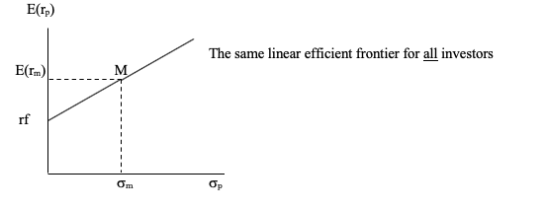
Implications of the CAPM assumptions – the same Efficient Frontier for all investors – the best Capital Allocation Line

Slide 6
Implications of the CAPM assumptions – the Market Portfolio
All investors choose the same portfolio of risky securities, which we call the Market portfolio
Market portfolio is the tangency portfolio on the linear efficient frontier
Market portfolio is a portfolio of all globally available risky assets in the proportion according to their market capitalization
Why everyone has to hold the Market? Homogeneous expectations assumption, we all have the same views.

Slide 7
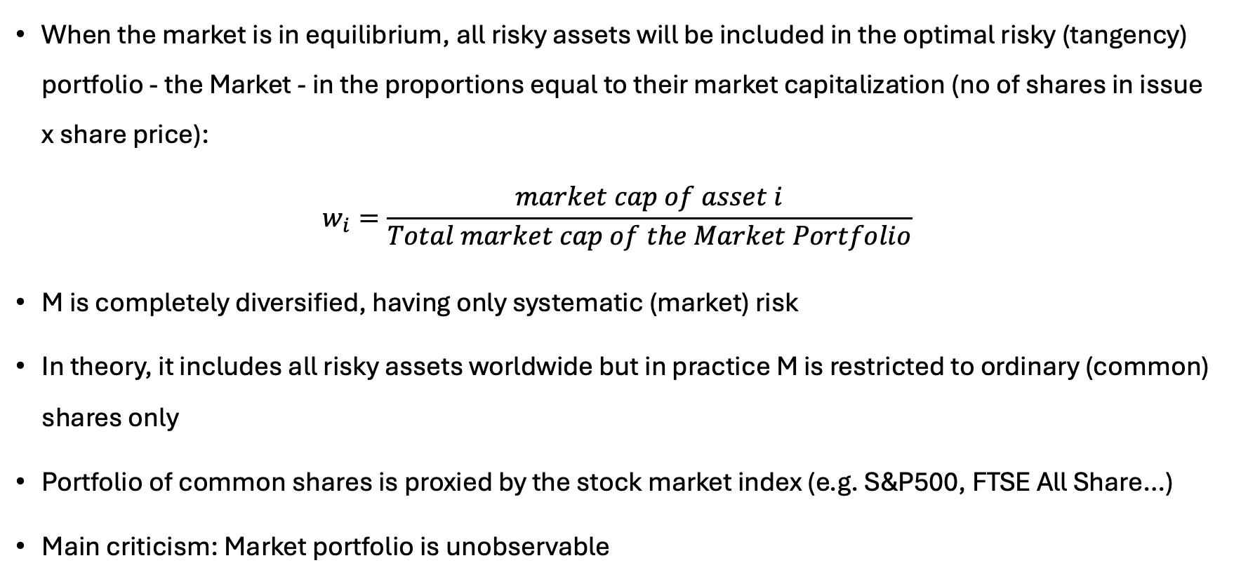
The Market Portfolio (M)
When the market is in equilibrium, all risky assets will be included in the optimal risky (tangency) portfolio - the Market - in the proportions equal to their market capitalization (no of shares in issue x share price):
$$w_{i}=\frac{market cap of asset i}{Total market cap of the Market Portfolio}$$
M is completely diversified, having only systematic (market) risk
In theory, it includes all risky assets worldwide but in practice M is restricted to ordinary (common) shares only
Portfolio of common shares is proxied by the stock market index (e.g. S&P500, FTSE All Share…)
Main criticism: Market portfolio is unobservable

Slide 8
Implication of the CAPM assumptions: the Separation Theorem
The investor makes two separate decisions:
which portfolio of risky assets to hold; which is purely a technicality as the implication of CAPM assumptions is that everyone should hold the Market portfolio, and
what should be the asset allocation between risky Market portfolio and the risk-free rate – that depends on investors’ risk aversion
Note:
In the CAPM world, one can determine the optimal combination of risky assets – the Market - without considering risk/return preferences

Slide 9
Risk-return relationships defined by the CAPM: CML vs. SML

Slide 10
Relationships defined by CAPM
Two relationships are derived from the CAPM:
1. Capital Market Line (CML) is determining the the equilibrium relationship between the total risk and the expected return of the efficient portfolios – it is the efficient frontier in the CAPM (that we have discussed on previous slides)
2. Security Market Line (SML) is determining the equilibrium relationship between systematic risk and the expected return of both individual securities and portfolios

Slide 11
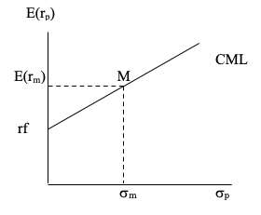
Capital Market Line (CML), cont.
CML characterized by the intercept (Rf) and the slope
The slope of the CML is called the expected return/risk tradeoff for efficient portfolios, i.e. the market price of risk for the efficient portfolios:
(E(R _{M}) - Rf) / σ_{M}
The equation of the CML is:
E(Rp) = Rf + [(E(R _{M}) - Rf) / σ_{M} ] σ_{p}
Where E(Rp) and σ_{p} are the expected return and standard deviation of the efficient portfolio

Slide 12
Capital Market Line (CML)
CML is efficient frontier in the CAPM
All portfolios that are not consisted from the market portfolio M and risk free lie below the CML, i.e. are inefficient
In equilibrium, all investors hold portfolios on CML
CML must be upward sloping (CAPM assumption: investors are risk averse)
  In practice, historical observations have shown that CML can be downward sloping
If a standard deviation of an efficient portfolio is known, CML enables an investor to identify the required rate of return on that portfolio

Slide 13
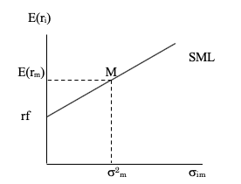
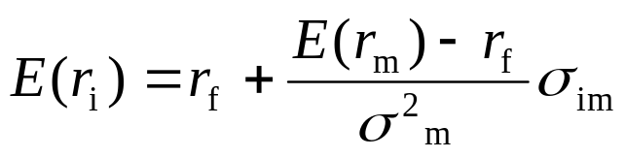
Security Market Line (SML)
In a well diversified portfolio, like M, the contribution of asset risk to the portfolio risk is given through its covariance with the portfolio
The relationship between the expected return and market risk of security can be presented in E(r_{i})/σ_{im} space
Similarly to the CML equation, the expected return of individual security known as the SML equation is:
The slope is the market price of risk, which determines the level of risk aversion of the market as a whole

Slide 14
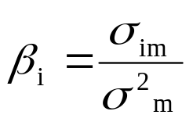
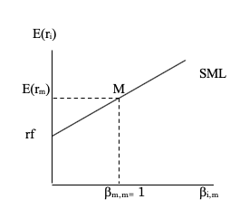

Security Market Line (SML)
Note that:
We can rewrite the SML equation as:
Expected return of an asset = risk free rate + risk premium
  Where E(R_{M}) - Rf is the market risk premium and β(E(R_{M}) - Rf) is risk premium for a security
Therefore, alternatively, SML line can be depicted in the E(r_{i})/β_{im} space

Slide 15
Interpretation of Beta
Beta measures the sensitivity of stock’s return to movements in the market return.
Market beta is equal to 1; Beta of the risk-free asset is 0
If the market return increases by 1%, then the following 5 stocks will exhibit the changes in returns as in the table below:
Stock | Beta | Change in the stock return | The stock is:
A | -0.5 | -0.5% | Negatively correlated and LESS volatile than the market
B | 0 | 0% | Not correlated with the market
C | 0.5 | 0.5% | Positively correlated and LESS volatile than the market
D | 1 | 1% | Perfectly positively correlated with the market
E | 1.5 | 1.5% | Positively correlated and MORE volatile than the market

Slide 16
Security Market Line (SML), cont.
SML is showing a tradeoff between risks and returns for all, where risk is measured using beta, an indicator of market risk
All securities plot on the SML, hence all portfolios plot on the SML too.
Therefore, efficient portfolios can be found on CML and SML, while the inefficient ones plot on the SML, below CML line.
If securities are not plotting on the SML line, they are undervalued (above SML) or overvalued (below SML)

Slide 17
Prices and CAPM

Slide 18
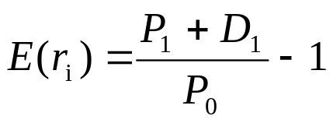
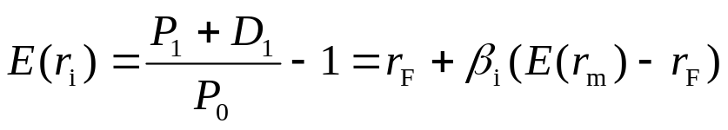
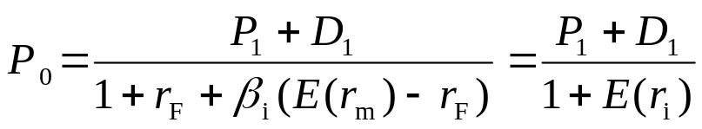
Prices and the CAPM
The return on asset i is:
CAPM postulates that:
So we have:
This is fundamental pricing equation in finance: price of an asset is a present value of its cashflows
Price and expected return have an inverse relationship

Slide 19
SML and undervalued/overvalued securities
Undervalued securities are plotting above the SML because they offer greater expected return for a given level of risk. Investors will start buying those securities, driving their prices up and returns down. Hence, the security will be driven to the SML level.
Overvalued securities are plotting below the SML line, not offering enough return for the given level of systematic risk. Investors action will be exactly the opposite from the above case, but the security price will be brought to the equilibrium.

Slide 20
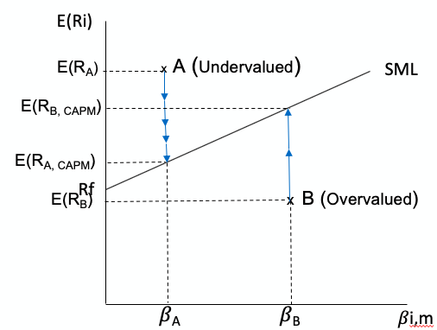
SML and undervalued/overvalued securities
Undervalued securities will go back to SML line quicker than the overvalued ones

Slide 21
Estimation of the SML in practice
Inputs needed: return on the risk-free asset, estimates of beta for any security in question and expected return of the market
As an estimate for Rf returns investors use T-bills
Estimates of the market returns: use historical data on Market Index
Estimating the beta: unique for every asset
  relates returns of individual security to the market returns
  estimated using regression analysis

Slide 22
The Single Index Model

Slide 23
The purpose of the Single Index Model
SIM obtains solutions to the general portfolio selection problem which are equivalent to those obtained by the full variance-covariance (Markowitz) portfolio selection model, but at lower cost, i.e. with less inputs
It allows separation of total risk (variance) into systematic and unsystematic risk
It improves variance-covariance matrix used in construction of efficient frontier and optimal portfolio

Slide 24

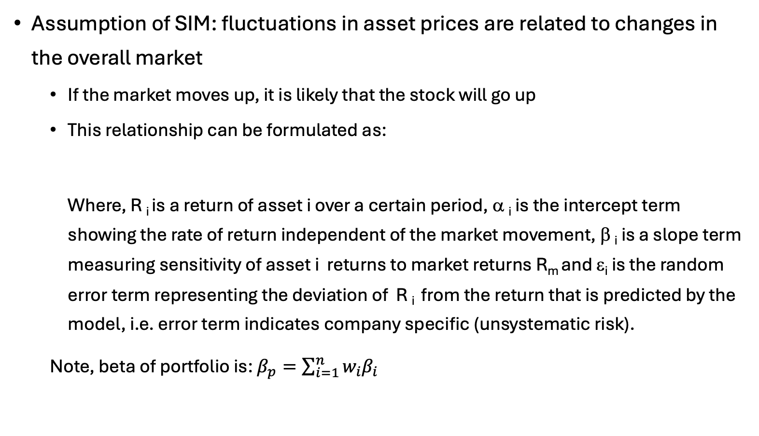
Single Index Model
Assumption of SIM: fluctuations in asset prices are related to changes in the overall market
  If the market moves up, it is likely that the stock will go up
  This relationship can be formulated as:
  Where, R _{i} is a return of asset i over a certain period, α _{i} is the intercept term showing the rate of return independent of the market movement, β _{i} is a slope term measuring sensitivity of asset i returns to market returns R_{m} and ε_{i} is the random error term representing the deviation of R _{i} from the return that is predicted by the model, i.e. error term indicates company specific (unsystematic risk).
  Note, beta of portfolio is: $β_{p}=\sum_{i=1}^{n}{w_{i}β_{i}}$

Slide 25
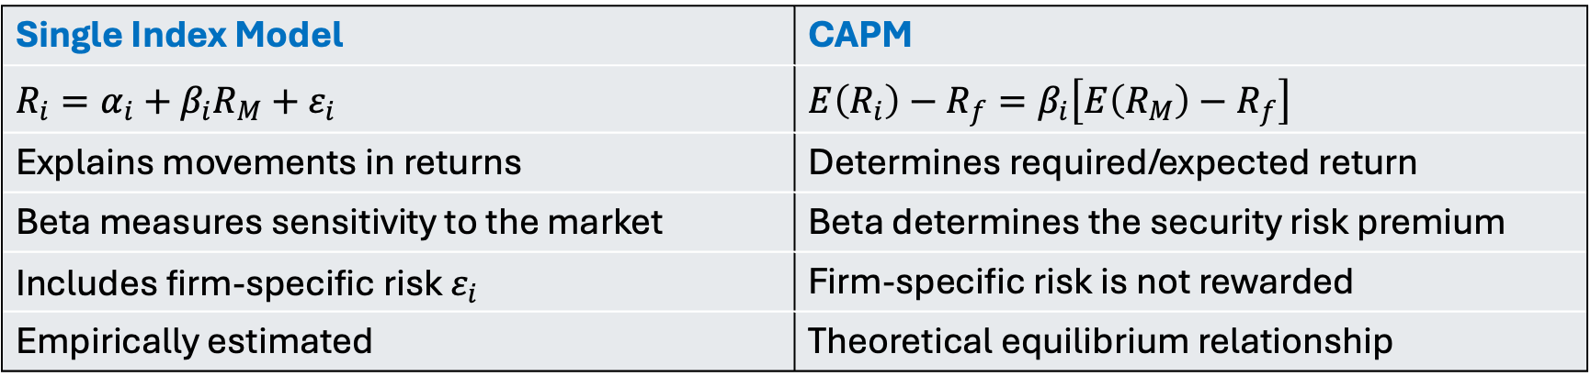
Comparison of SIM vs. CAPM
SIM is primarily a statistical model of realised returns
CAPM is an equilibrium model of expected returns
Single Index Model | CAPM
$$R_{i}=α_{i}+β_{i}R_{M}+ε_{i}$$ | $$E\left(R_{i}\right)−R_{f}=β_{i}\left[E\left(R_{M}\right)−R_{f}\right]$$
Explains movements in returns | Determines required/expected return
Beta measures sensitivity to the market | Beta determines the security risk premium
Includes firm-specific risk $ε_{i}$ | Firm-specific risk is not rewarded
Empirically estimated | Theoretical equilibrium relationship

Slide 26
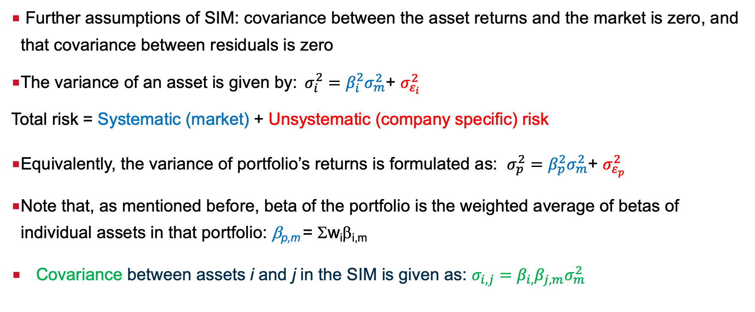
Variances and covariances in the Single Index Model
Further assumptions of SIM: covariance between the asset returns and the market is zero, and that covariance between residuals is zero
The variance of an asset is given by: $σ_{i}^{2}=β_{i}^{2}σ_{m}^{2}$+ $σ_{ε_{i}}^{2}$
Total risk = Systematic (market) + Unsystematic (company specific) risk
Equivalently, the variance of portfolio’s returns is formulated as: $σ_{p}^{2}=β_{p}^{2}σ_{m}^{2}$+ $σ_{ε_{p}}^{2}$
Note that, as mentioned before, beta of the portfolio is the weighted average of betas of individual assets in that portfolio: β_{p,m} = Σw_{i}β_{i,m}
Covariance between assets i and j in the SIM is given as: $σ_{i, j}=β_{i,}β_{j,m}σ_{m}^{2}$

Slide 27
Importance of R²
Goodness of fit of the regression line (fitted line): coefficient of determination R²
R² ranges between 0 and 1 and it measures the proportion of movements of the dependent variable that is explained by the independent variable
R² is higher for a diversified portfolio than for an individual security

Slide 28
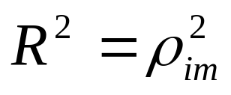
R-squared and correlation coefficient
R-squared is the squared value of the correlation coefficient between the dependent and the independent variable, i.e. the correlation between the returns of the market index used as a proxy and a portfolio (security) whose beta we are estimating:
If R² in the market model regression is 0.81, what is the correlation coefficient between the market index and portfolio in that regression?
What additional information would you need to answer this question?

Slide 29
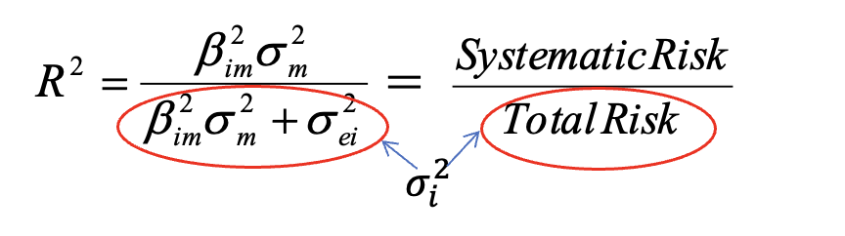
R-squared and diversification
Higher R² – more diversified portfolio
R² shows the proportion of the market risk of a security (portfolio) in the total risk of a security (portfolio):
So, if portfolio has standard deviation of 10% and R² from SIM regression of 0.81, the proportion of its systematic risk in the total risk is 81% and the value of its systematic risk is 0.0081 (= 0.1²x0.81)

Slide 30
Estimating Betas - Issues
Use of historical data (typically 60 months, but could be more or less)
Constant from a model
In reality: time varying betas
Estimation errors
  Smaller for a diversified portfolio than for individual security

Slide 31
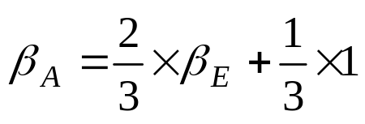
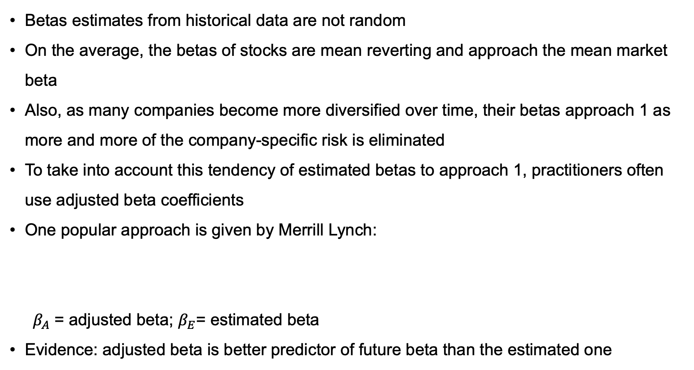
Adjusted beta
Betas estimates from historical data are not random
On the average, the betas of stocks are mean reverting and approach the mean market beta
Also, as many companies become more diversified over time, their betas approach 1 as more and more of the company-specific risk is eliminated
To take into account this tendency of estimated betas to approach 1, practitioners often use adjusted beta coefficients
One popular approach is given by Merrill Lynch:
$β_{A}$ = adjusted beta; $β_{E}$= estimated beta
Evidence: adjusted beta is better predictor of future beta than the estimated one

Slide 32
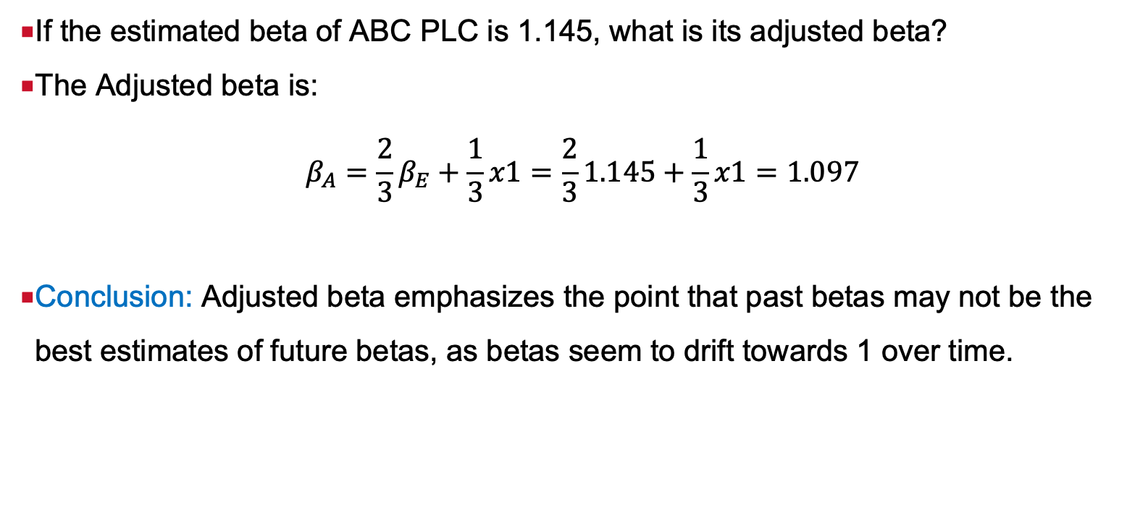
Adjusted Beta - Example
If the estimated beta of ABC PLC is 1.145, what is its adjusted beta?
The Adjusted beta is:
$$β_{A}=\frac{2}{3}β_{E}+\frac{1}{3}x1=\frac{2}{3}1.145+\frac{1}{3}x1=1.097$$
Conclusion: Adjusted beta emphasizes the point that past betas may not be the best estimates of future betas, as betas seem to drift towards 1 over time.

Slide 33
Multi-factor models

Slide 34
Why multi-factor models?
Can we really hold the Market portfolio, as defined by the CAPM? NO!
Is market the only factor that explains movements in portfolio returns? NO!
So that means that CAPM is not really useful….YES and NO!
- There are more accurate models with more factors
    - CAPM serves as a basis for some widely used performance measure such as Sharpe ratio and alpha

Slide 35
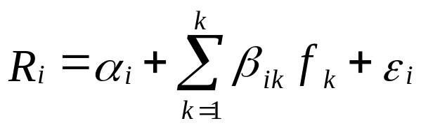







Multi-factor model – general equation
Based on Arbitrage Pricing Theory: asset returns are driven by a series of factors
The linear factor model can be written as:
The are the k factors, are the factor betas (factor loadings) or measures of sensitivity of asset i to factor and represents the residuals or unsystematic risks. The APT therefore assumes that there are k factors that are mainly responsible for the movements in the prices of all assets. is the expected return on asset i. The difference between the actual return ( ) and the expected return is due to the influence of k factors ( ).
$$R_{i}=α_{i}+β_{i1}f_{1}+β_{i2}f_{2}…+β_{ik}f_{k}+ε_{i}$$

Slide 36
Factors and their characteristics
APT: security returns are related to the unknown number of the unknown factors
  Important to note: the theory doesn’t specify what the factors are (e.g. changes in interest rate, changes in oil price, etc.)
Characteristics of factors:
  They must influence expected returns
  They must be uncorrelated to one another
  They are a source of risk
  Risk factor must be unpredictable at the beginning of each period
  This means that factors are random variables, with E( f )=0

Slide 37
Model example: Fama-French (1993) Three-Factor Model
Fama and French (1992) identify two groups of stocks consistently tended to outperform the market as a whole:
(i) small cap stocks and
(ii) stocks with a high book-value-to-price ratio (value stocks)
Fama and French (1993) add two factors, SMB and HML, to the original CAPM to reflect a portfolio's exposure to these two factors as:
SMB: returns of small-cap minus returns of big-cap stocks
HML returns of high book-to-market (value) minus returns of low book-to-market (growth) stocks

Slide 38
Model example: Carhart (1997) Four-Factor Model
Including the momentum factor, the Fama-French model becomes a four-factor model:
WML: momentum factor represents winner minus loser portfolio return. It is is constructed as an equally weighted average of top 30% of firms with highest returns in previous 11 months minus equally weighted average of the 30% firms with the lowest returns in previous 11 months.

Slide 39
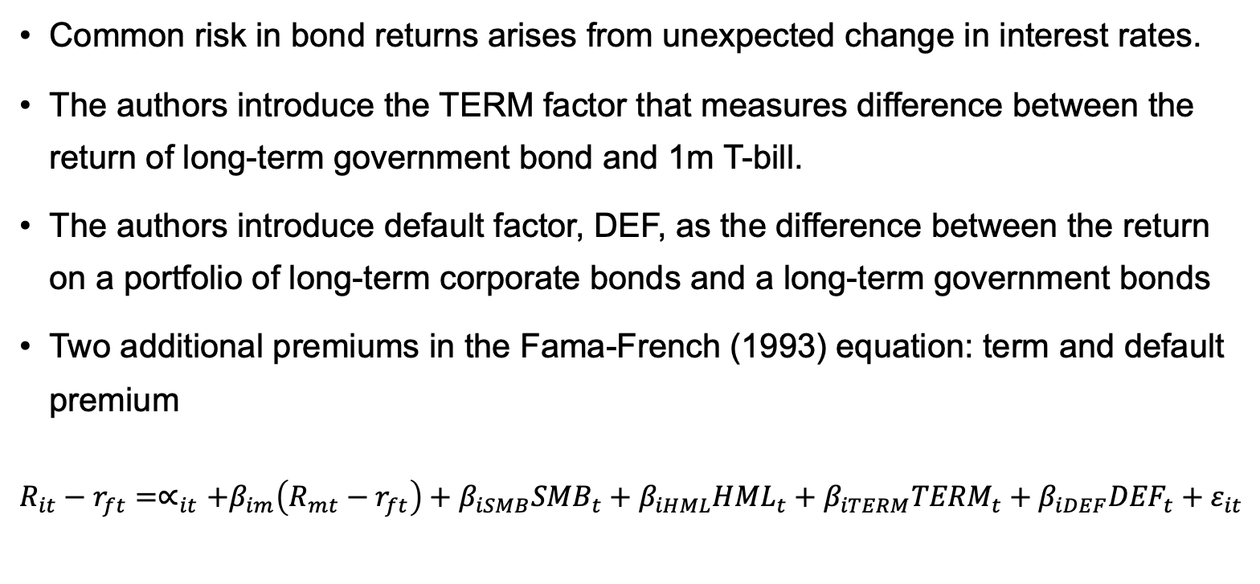
Model example: Fama-French (1993) for stocks and bonds
Common risk in bond returns arises from unexpected change in interest rates.
The authors introduce the TERM factor that measures difference between the return of long-term government bond and 1m T-bill.
The authors introduce default factor, DEF, as the difference between the return on a portfolio of long-term corporate bonds and a long-term government bonds
Two additional premiums in the Fama-French (1993) equation: term and default premium
$R_{it}−r_{ft}=∝_{it}+β_{im}\left(R_{mt}−r_{ft}\right)+β_{iSMB}{SMB}_{t}+{β_{iHML}{HML}_{t}+β_{iTERM}{TERM}_{t}+β_{iDEF}{DEF}_{t}+ε}_{it}$

Slide 40
How many factors? Which model to use?
Not enough factors? What else can one use?
  Liquidity?
  Volatility?
  Literature suggests over 300 potential factors that can be used – “factor Zoo”
Too many factors?
  That seems to be the case
  For instance, in equity mutual fund space, there is no evidence that any of the factors studied in the literature consistently add value to the Fama-French (1993) or Carhart (1997) model
  Recent literature suggests the way how to identify factors that may be better to use than others but no clear guidance on that

Slide 41
Applications of multi-factor models
Used as the basis for many of the commercial risk systems such as MSCI Barra
Custom portfolio building
  Portfolios have certain required characteristics
  e.g. an oil company wants a pension fund portfolio immunised against oil price risk: build a portfolio with low exposure to oil price movement and unexpected inflation
Sensitivity analysis of the existing portfolio
  How would your portfolio perform if there was steepening of the yield curve?

Slide 42
Reading
Reading on Moodle
Elton, Gruber, Miles and Goetzmann, “Modern Portfolio Theory and Investment Analysis”: parts of Chapter 7 and Chapter 8 for single factor and multi-factor model; parts of Chapter 13 for the CAPM

